Slide 1
What I Learned from All those hours of History!

Slide 2
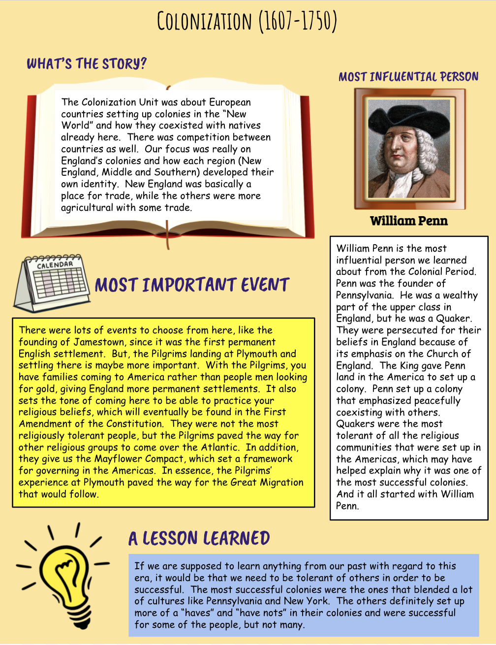

Slide 3
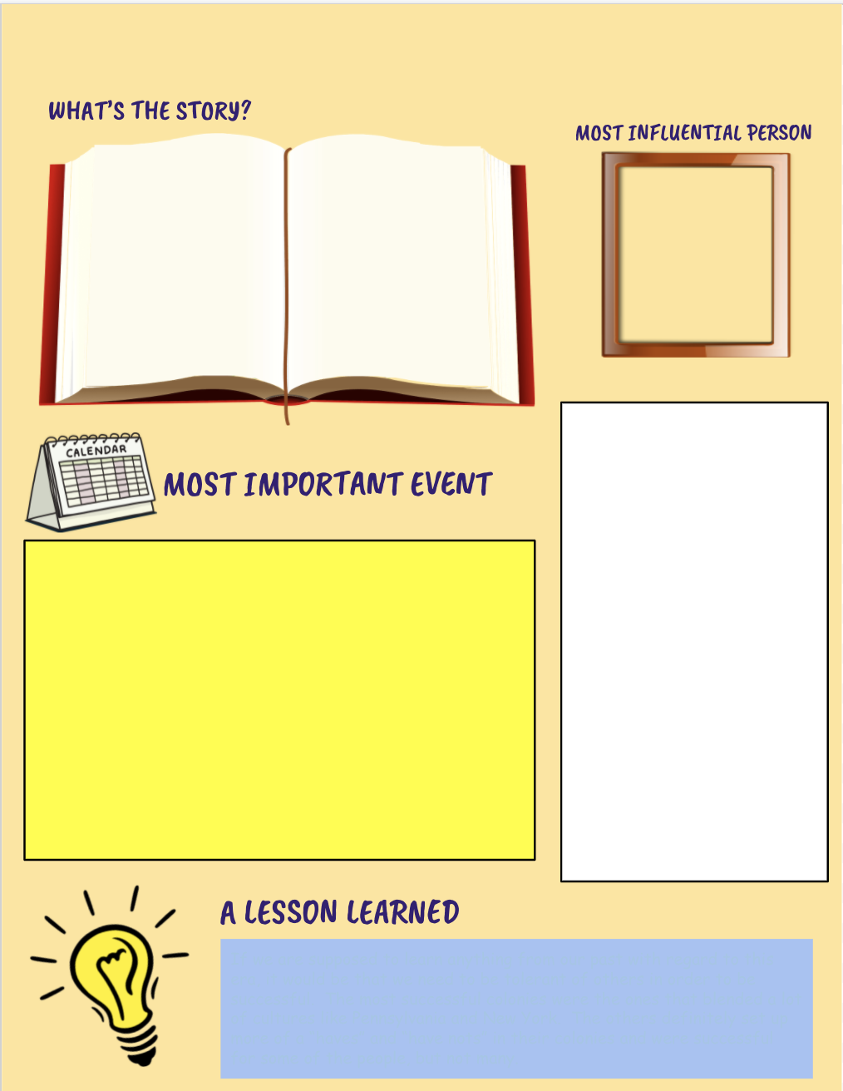
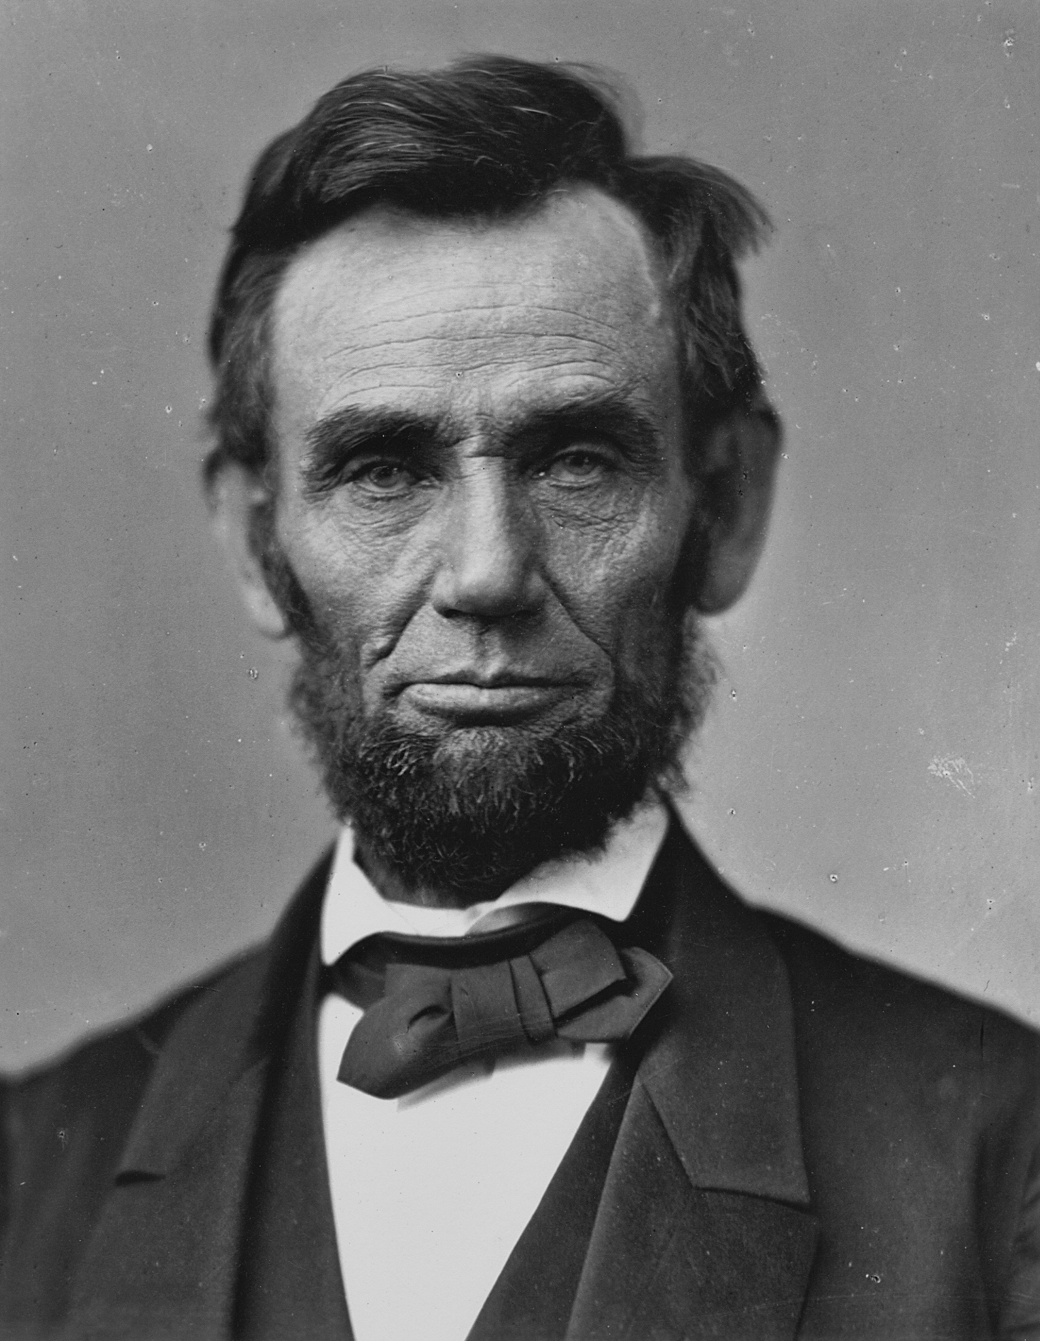
Unit 8 The Civil War
Google Slides Presentation:
(CLICK HERE)
The unit abraham lincoln is most mentioned in is the civil war unit. The most important event in this unit is the civil war. I learned many things especially about the battles and the generals who led them. I also learned about things like the anaconda plan and why the confederacy broke off from the Union.
Abraham Lincoln
Abraham lincoln was the president at the time during the civil war. He ran in the election of 1860. He realized that the war would be long when they lost the first battle at bull run. When he gave orders for his troops to fight and they won boosted the confidence of the Union and him getting his second term as president. He got the second term but was then assassinated in a theatre
The most important event in this unit was the civil war. The Civil War started when Abraham lincoln was elected president. The southern states did not like this and broke off from the Union. They called themselves the confederacy, the state that was first to leave was south carolina. The rest of the southern states broke off with time. The states started to fight and had many memorable battles like the battle at bull run or the battle of gettysburg. This is so important because it was a civil war between a country that had just become free and it was the most deadly battle to american people in any war.
I have learned many things about this war but I think that America has learned the most. The US learned that we shouldn’t go into another civil war because it can cause lots of bloodshed across america.

Slide 4
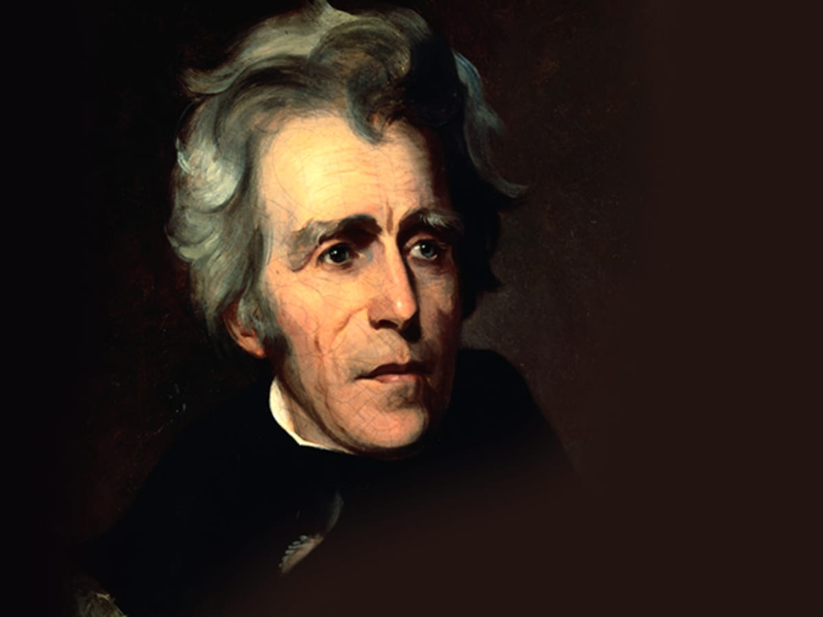
The Jacksonian era
This unit was about Andrew Jackson an what happened to the country during his time. Many things like kicking out the Natives and suing banks happened in this era.
Andrew jackson
Andrew Jackson was the president at the time when the Cherokees were kicked out of their land. He was not a very good president and was the man who told the southerners to kick the Cherokees out of their land. Many things happened in his presidency that made him look bad like the bank being taxed
The most important event was the trail of tears. Andrew Jackson was elected president and had started to do some bad things. Many southerners were angry they didn’t have more land and more slaves so they wanted the land they promised the cherokees could keep. Andrew Jackson said light a fire under them they’ll move. So the southerners kicked them out of their homes and they were sent to live in oklahoma. The trail was so long nearly ¼ of the cherokees died along the way.
I have learned that many other things happened like the trail of tears to other people. I learned that this is a very bad thing to do and it could be very bad if you did it again.

Slide 5
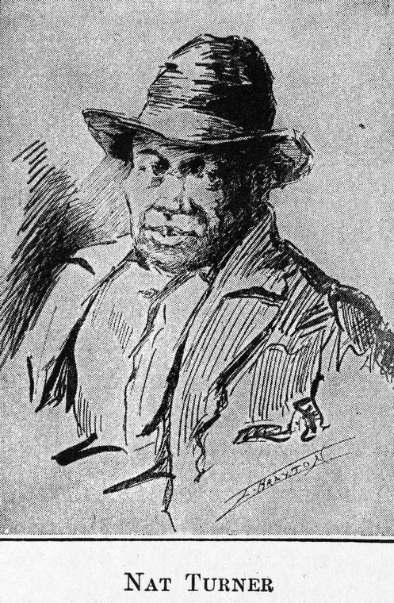
Sectionalism
In this unit many things were going on in the south with slavery. Many slaves were rising up against their owners and were taking a stand. The two most famous of these were Nat Turner and Harriet Tubman. Nat Turner started a revolt and killed all of the white people there including babies. Harriet Tubman Helped other slaves escape on the underground railroads.
Nat Turner
Nat turner was a slave who started a huge revolt ending up killing many people. He was taking a stand against white slave owners by killing their entire family.
The most important event in this unit was Nat Turner's revolt. In this event Nat Turner and all of the other slaves with him ran into white people's homes and killed all of them including the babies. The reason they did this was because they were tired of being treated like garbage and wanted to have their own lives. The reason he killed little babies was to keep them from growing up and becoming slave owners
I learned that some heroes don’t do the right thing and can sometimes even become criminals in trying to do the right thing.

Slide 6
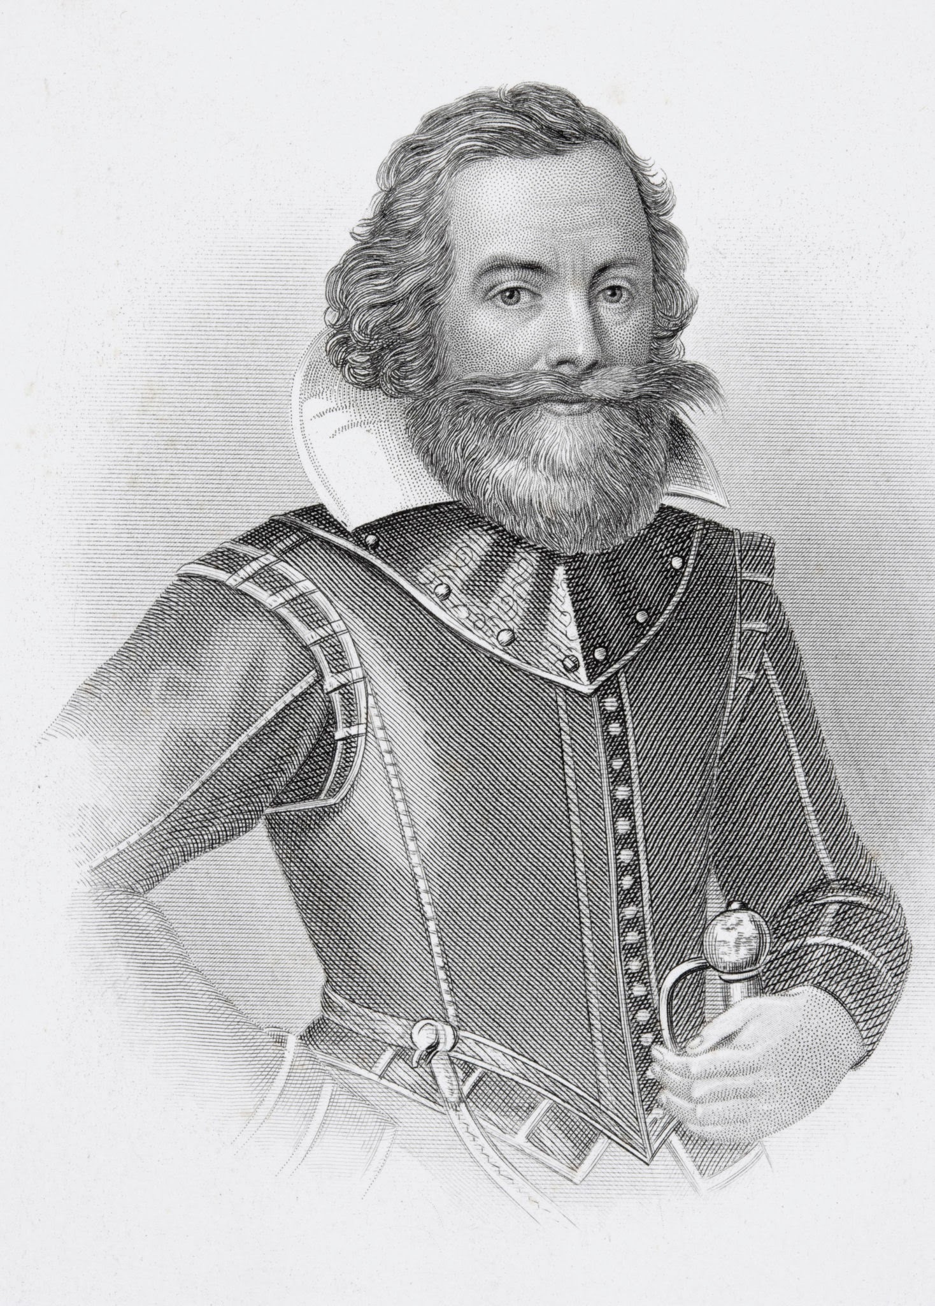
Colinization
In this unit john smith and many other european men sailed across the ocean to find a new land which they did. They didn’t have a good start and ended up killing some of the natives with new diseases brought over. They didn’t have much money but found out about tobacco.
John smith
John smith was the man who led the ships over to the new land. He was trying his best to sustain the life in the new places but it was troublesome. They found out about tobacco and everyone started to plant it and it saved the entire colony of Jamestown.
The most important event wa when the people started to plant tobacco and it became the most selling item in the land. The reason it helped so much was because not many people had money so they were starving and couldn’t afford those things. Natives in the land were attacking the newcomers at first then realized they needed help. Tobacco is the reason that this nation is still here today.
I learned that if john smith and tobacco weren’t around the entire nation of the USA wouldn’t be here. I know that things like tobacco are bad for you but in some cases they can help start getting money.

